Slide 1
Springs Protection Options Septic System Evaluation Program
Board of County Commissioners Meeting
November 13th 2012

Slide 2
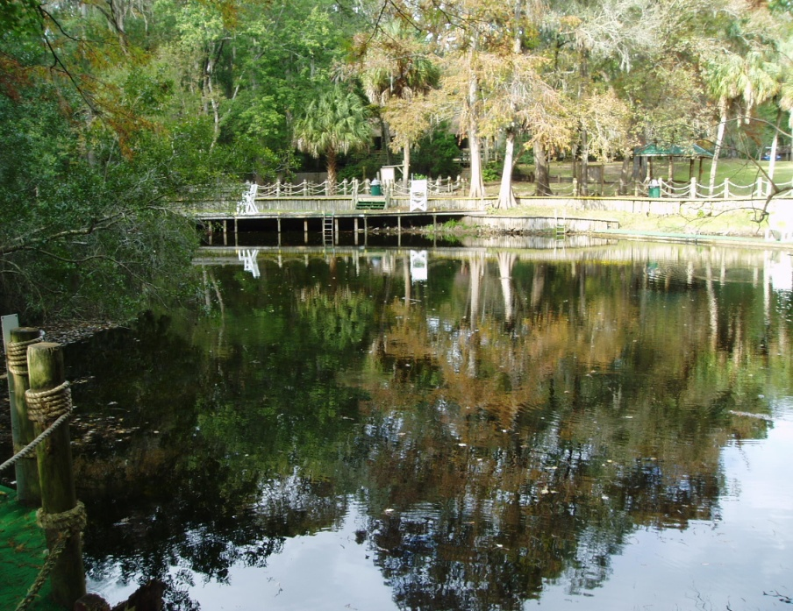
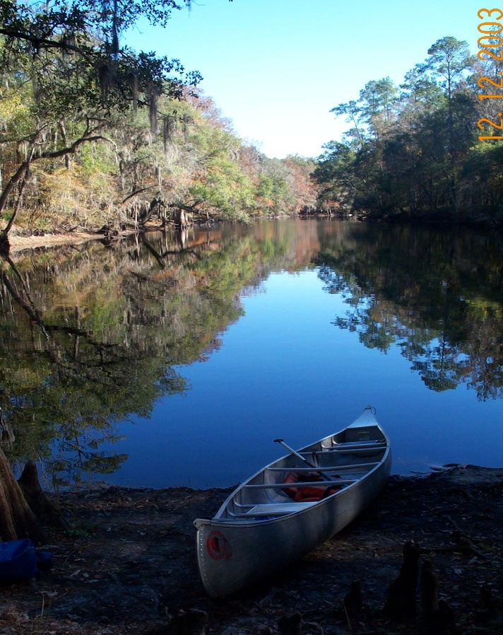
The Issue
Declining water quality in the Santa Fe River and Springs due to elevated nitrate concentrations
River Rise (left) and Hornsby Springs (above)

Slide 3
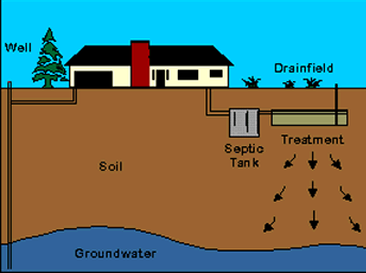
Potential Sources of Nitrate*
Agriculture 59%
Septic 17%
Silviculture 14%
Other 10%
*AMEC. 2012. Sources of Nitrate and Estimated Groundwater Travel Times to Springs of the Santa Fe River Basin
Agriculture includes field crops, sod, orchards, nurseries, pasture, row crops, and CAFOs
Other includes commercial, institutional and recreational land uses; wastewater facilities, residential land use

Slide 4
Groundwater Nitrate Levels 2012

Slide 5
F.S. 381.00651
The Statute requires counties that contain a first magnitude spring to adopt a septic system inspection program on or before January 1, 2013.
The statute also provides counties the ability to opt-out of the program requirements upon adoption of a resolution by at least a 60 percent vote.
Alachua County contains three first magnitude springs, Treehouse, Hornsby and Santa Fe Rise

Slide 6
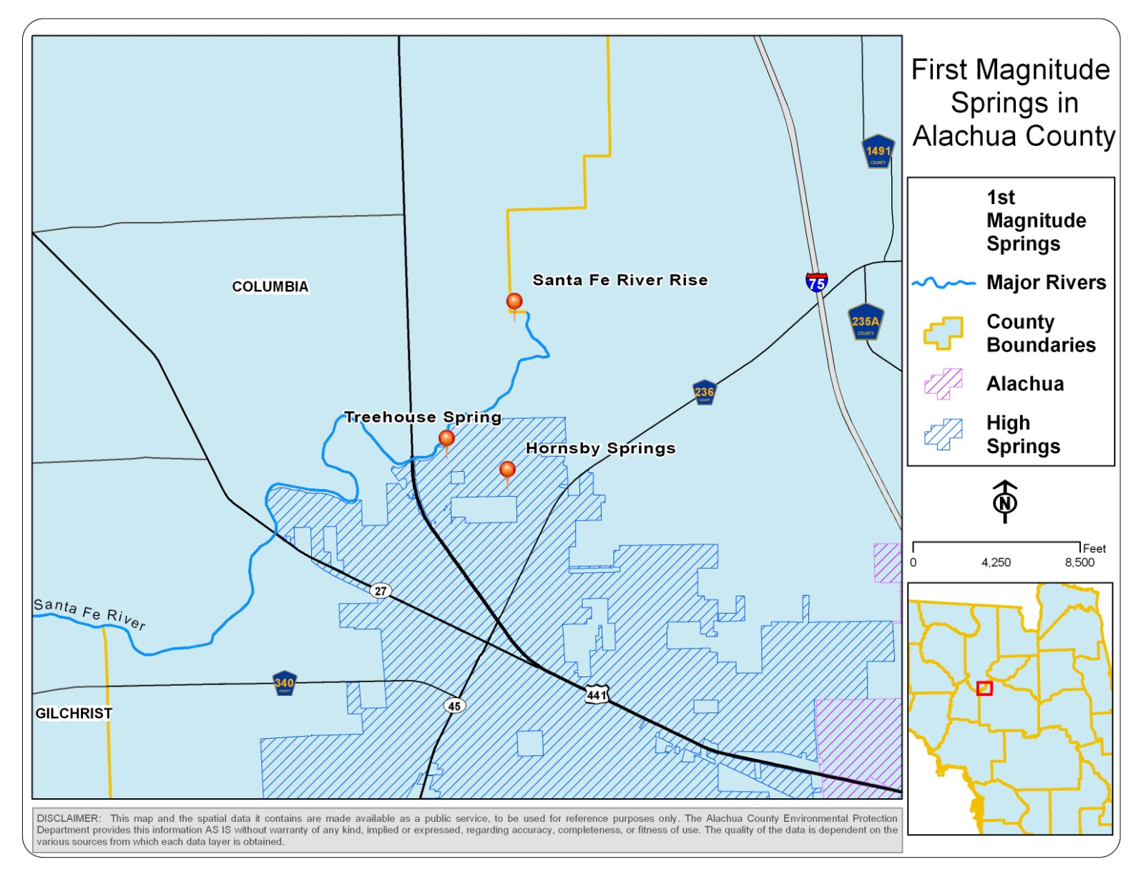
First Magnitude Springs located in Alachua County

Slide 7
Code Provisions
System evaluations and mandatory pump-outs every 5 years
May not mandate an evaluation at the point of sale in a real estate transaction
Residential units on a lot with a ratio of one bedroom per acre or greater are exempt
May not require a soil evaluation
Evaluation shall include the tank and drain field
Evaluation shall include a written assessment

Slide 8
Code Provisions
May not require a repair, modification, or replacement of a system unless the evaluation identifies a system failure (sanitary nuisance)
An engineer-designed performance-based treatment system to reduce nutrients may not be required as an alternative remediation measure to resolve the failure of a conventional system
Evaluation to be performed by qualified contractors
Program to be managed by Health Department
May not deviate from the requirements outlined in F.S. 381.00651

Slide 9
Septic System Inventory, Code Applicability, and Cost
Applicability – Countywide or Targeted Locations
Countywide: 30, 411 septic systems
25 Year Travel Time: 3,507 septic systems
High Springs: 1,639 septic systems
Cost –
Average cost of $500 - $600 per evaluation

Slide 10
Floridan Aquifer 25-year Modeled Groundwater Travel Time

Slide 11
Issues
Prohibits requirement of inspections at the point of sale in a real estate transaction
Does not allow any flexibility on timing of inspections for systems serving small households or second homes that don’t see much use
May not require a repair, modification, or replacement of a system unless the evaluation identifies a system failure (sanitary nuisance)

Slide 12
Potential Environmental Benefits
Nitrate Load Reduction
As stated before, approximately 17% of the nitrogen load to Santa Fe River Basin Springs can be attributed to septic systems; however, the proposed program will not lower that base load since the load estimate is based on functioning septic systems
Actual base load reductions could be achieved by
Performance-based treatment system
Requiring modifications to systems for non-“system failure” problems, for example not meeting the minimum separation distance between the drain field and the wettest season water table.
Both of these potential requirements are prohibited under F.S. 381.00651.

Slide 13
Staff Recommendations
Adopt Resolution opting-out of the Septic System Evaluation Program (the Statute requires approval of the Resolution by at least 60% of the Commission)
Request that the Legislature modify the existing Statute to allow for greater flexibility in local Ordinances.
Request that Springs Protection be a priority issue in the County’s 2013 Legislative Agenda

Slide 14
Springs Protection Options Septic System Evaluation Program
Board of County Commissioners Meeting
November 13th 2012

Slide 15
Proposed Modifications to F.S. 381.00651
Allow flexibility for:
Repair, modification, or replacement of a systems
Performance-based treatment system
Inspections at the point of sale
Alternative inspection schedule for systems serving small households or second homes

Slide 16
Article 8 Springs and High Aquifer Recharge Areas
Chapter 78, Fertilizer Standards and Management Practices
Chapter 79, Irrigation Conservation Standards and Management Practices
Chapter 353, Hazardous Materials Management Code
Chapter 404, Article 24, Mining or Excavation and Fill Operations
Chapter 404, Article 14, Entertainment and Recreation
Chapter 406, Article 2, Trees and Native Vegetation
Chapter 406, Article 6, Surface Waters and Wetlands
Chapter 406, Article 12, Wastewater Treatment Facilities
Chapter 406, Article 16, Significant Geologic Features
Chapter 407, Article 4, Landscaping
Chapter 407, Article 5, Open Space
Chapter 407, Article 9, Stormwater Management

Slide 17
Article 8 Springs and High Aquifer Recharge Areas
Outdoor Water Conservation for new development
High-volume irrigated areas shall not exceed 60% of the landscaped area. The maximum total irrigated area on residential lots shall not exceed 0.5 acres
Prohibition on:
Rapid infiltration basins
Class A and B biosolids
Septage
Design standards for golf courses

Slide 18
Spring Protection Strategies
• Update Fertilizer Code
• Update Landscape Irrigation Code
• Media Outreach Campaign
• Increase Role of County Staff in Consumptive Use Permits
• Enhanced Monitoring and Research
Turf buyback program

